Slide 1
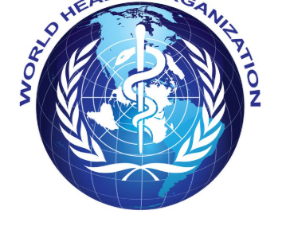
WHO HIV Data Analysis Dashboard
Healthcare Data Analytics Project
Created by : Onye Nnenna
Tools Used: Power BI, DAX, Power Query

Slide 2
Project Overview
This project analyzes global HIV trends using WHO datasets to uncover insights into deaths , treatment coverage, and survival outcomes globally.
The dashboard was developed using Power BI , DAX, and Power query to support healthcare decision making through data driven insights.

Slide 3
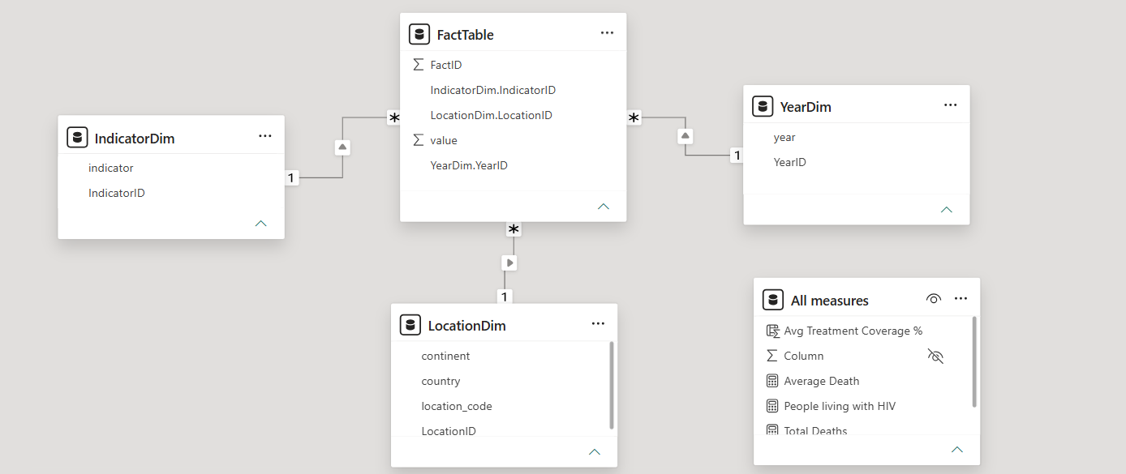
Data Modeling
The dataset was transformed into a clean star schema model consisting of one Fact table Multiple dimension tables including Year Dim , Indicator Dim , Location Dim. Dax measures were created to support KPI calculations and time intelligence analysis.

Slide 4
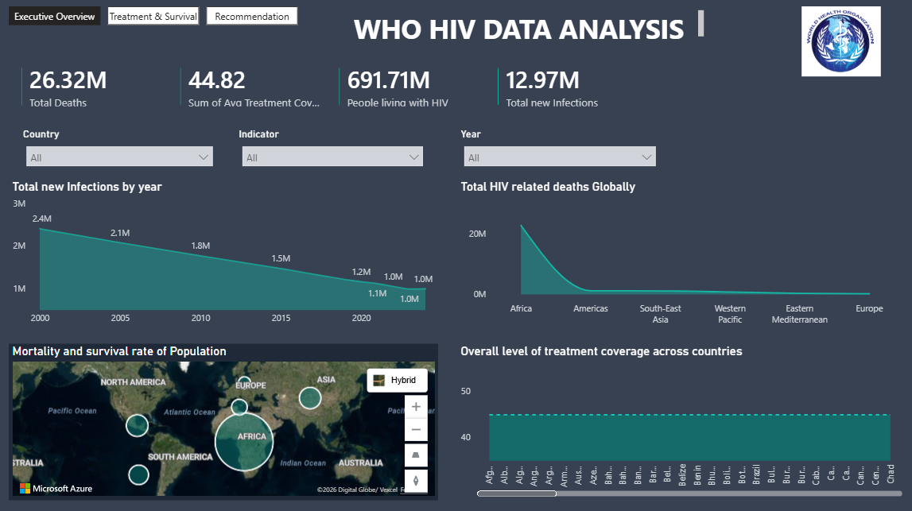
Executive Overview Dashboard
Insights
HIV Infections declined over time globally.
South Africa recorded the highest level of new infections
.
HIV related deaths shows a significant low trend generally but the trend is still high in some parts of Africa as seen in the dashboard.
Treatment coverage improved significantly globally leading to increased survival outcomes and decreased mortality .

Slide 5
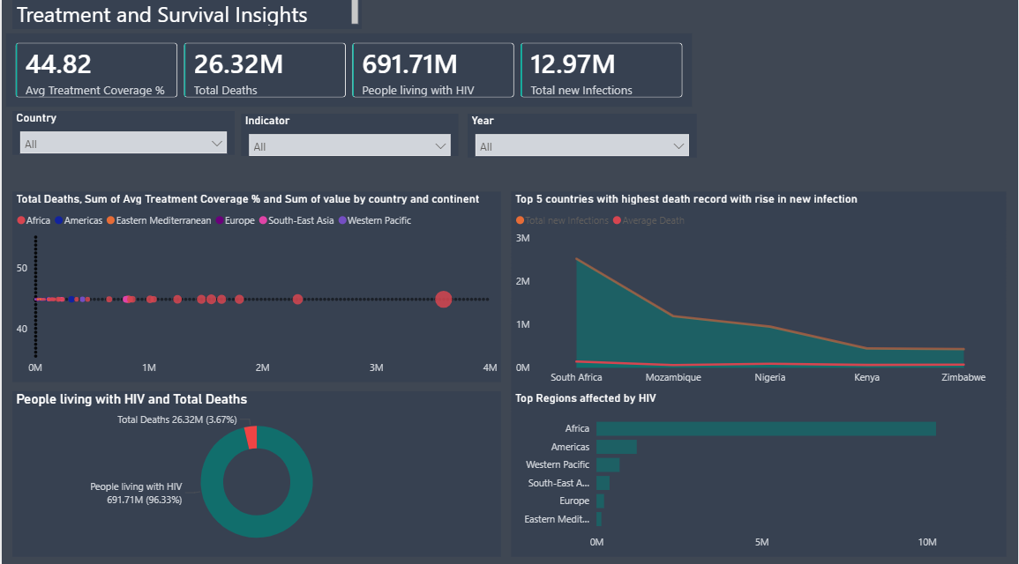
Treatment and Survival Insights
Insights
Countries in Africa are the most affected with new cases of HIV.
Africa is the region associated with the most HIV related deaths in total population.
Africa is the top region affected by HIV followed by America.
Data shows that globally there is an equal average treatment coverage.

Slide 6
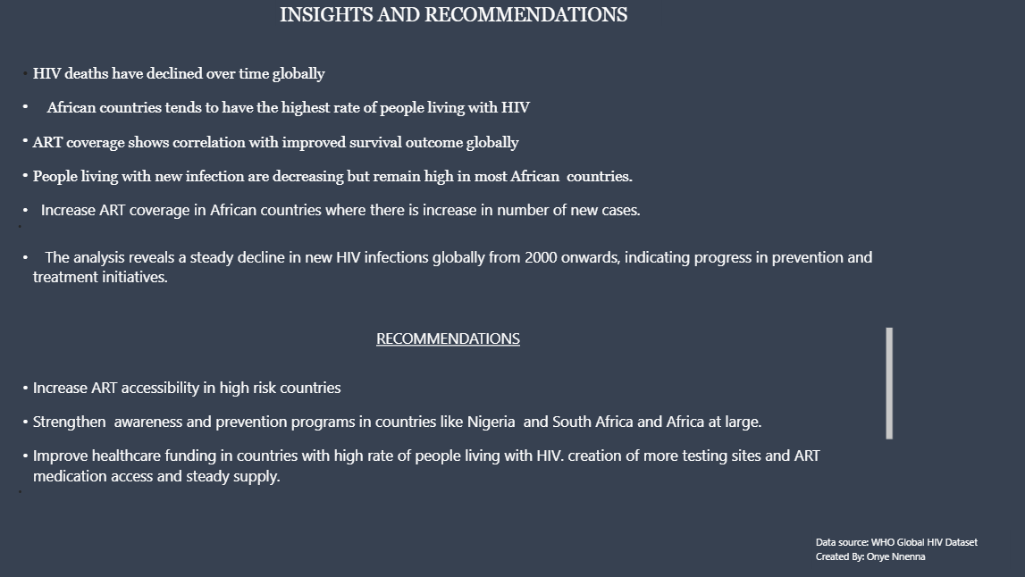
Recommendation
Insights
Increase ART accessibility in high risk countries.
Expand HIV awareness and prevention programs across Africa.
Increase funding to improve testing facilities are expanded into rural areas and made easily accessible .
Strengthen treatment initiative globally.
Ensure constant and monitored viral load tests.

Slide 7
Conclusion
This project demonstrates how healthcare data analytics can support informed public health decision and improve HIV intervention strategies globally.
The dashboard highlights regions with increasing HIV infections and identifies countries with high mortality. infection and new infection rates.
The analysis has revealed that that improved treatment coverage and ART accessibility have contributed significantly to reduction in HIV infection related deaths since 2000-2024.
However, despite the global decline in mortality , new infections , new infections remain high in several regions, indicating the need for continuous and increased support and investment in prevention, awareness, testing, treatment and accessibility globally.
THANK YOU.
Questions?

